Slide 1

Survey Presentation on
Survey Title: Architectural Innovations for Real-Time Machine Learning in Healthcare
Group - 16
CSCE 5610.001 - Computer System Architecture
Team Members:
Uday Bhaskar Valapadasu 11696364
Tulasi Sai Pechetti 11663410
Jayakrishna Amathi 11697680
Presentation Details
Date : 12/5/2024
Time : 11:30am-11:45am

Slide 2

Agenda
Abstract
Introduction
Understanding the Papers
Related Work Analysis
Enhancements and Future Directions
Comparative Analysis
Conclusions
References

Slide 3
Abstract
Key Goal: This survey explores the transformative role of deep learning in bioinformatics, focusing on genomics and structural biology.
Three Focus Areas:
  Deep learning in genomics (e.g., GenomeNet-Architect for optimizing workflows).
  Structural bioinformatics advancements (e.g., AlphaFold for protein structure prediction).
  Challenges like high resource requirements, interpretability, and dataset imbalance.
Future Vision: Multi-modal deep learning models and enhanced model interpretability are crucial to overcoming current limitations.

Slide 4
Introduction
Bioinformatics:
An interdisciplinary field combining biology, computer science, and statistics for analyzing and interpreting biological data.
Deep learning (DL):
A subset of machine learning that automatically extracts hierarchical features for tasks like image recognition, sequence analysis, and protein structure prediction.

Slide 5
Introduction
Highlight DL’s impact:
  Genomics: Genomics is the study of an organism's complete genetic information . Decoding massive genetic datasets for insights into diseases, mutations, and evolution.
  Structural Bioinformatics: Predicting 3D protein structures to accelerate drug discovery.
Challenges:
  High computational costs.
  Limited model interpretability.
  Imbalanced and noisy datasets in biological research.

Slide 6
Objectives of the Survey
Transformation Analysis:
  How DL is changing traditional bioinformatics approaches
  Impact on data processing and analysis
Sector Focus:
  Genomics: DNA/RNA sequence analysis
  Structural biology: Protein structure prediction
Integration Assessment:
  ML/DL incorporation into existing workflows
  Challenges and successes in implementation

Slide 7
Understanding the Papers
Paper 1: ML Integration in Bioinformatics
Challenges:
  Biological data is complex and noisy. Lack of explainability in ML models. Imbalanced datasets reduce model reliability.
Proposed Solutions:
Hybrid models using domain knowledge.
Explainable AI (XAI) for better interpretability.
Synthetic data generation to balance datasets.
Federated learning to train models securely.
Impact: Improves genomic data processing and insights for diagnosis.

Slide 8
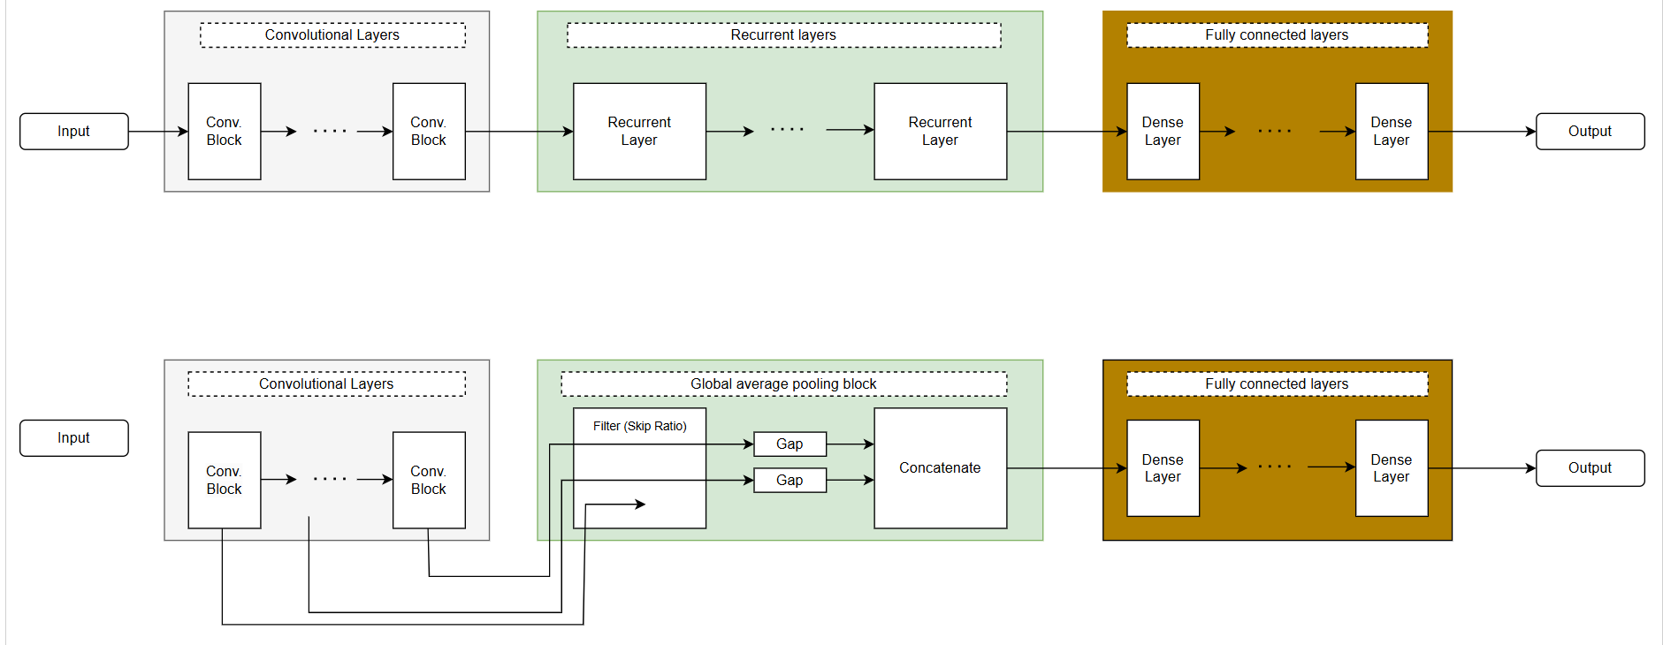

Slide 9
Understanding the Papers
Paper 2: GenomeNet-Architect
Challenges:
Deep learning models require high computational resources.
Genomic data's sequential nature isn’t fully leveraged.
Proposed Solutions:
Customized neural architectures for genomics.
Hyperparameter optimization to reduce resource demand.
Transfer learning for task-specific fine-tuning.
Model compression for smaller, faster systems.
Impact: Faster identification of genetic disorders. Enhances research on personalized treatment plans.

Slide 10
Understanding the Papers
Paper 3: AlphaFold and Structural Bioinformatics
Challenges:
High computational costs in protein prediction (e.g., AlphaFold).
Difficulty in predicting rare protein structures.
Lack of accessible resources for small-scale labs.
Proposed Solutions:
Self-supervised learning for unlabeled protein datasets. Used CNN, RNN.
Lightweight models for structure prediction.
Integration of multi-modal data (genomic + structural).
computing platforms for distributed analysis.
Impact: Accelerates drug discovery by predicting target molecules. Better understanding of protein interactions for diseases.

Slide 11
Related Work Analysis
Integration of ML in Traditional Bioinformatics
Strengths:
  Automated feature extraction
  Improved handling of large datasets
  Enhanced predictive modeling capabilities
Weaknesses:
  Complex biological data interpretation
  Limited model transparency
  Generalization challenges

Slide 12
Related Work Analysis
Domain-Specific Architectures
GenomeNet-Architect Innovations:
  Optimized layer configurations
  Enhanced parameter tuning
  Improved computational efficiency
Implementation Challenges:
  Resource requirements
  Accessibility limitations
  Training complexity

Slide 13
Related Work Analysis
Structural Bioinformatics Applications
AlphaFold Achievements:
  High-precision structure prediction
  Revolutionary approach to protein folding
  Impact on drug discovery
Current Limitations:
  Computational intensity
  Data imbalance issues
  Interpretability challenges

Slide 14
Enhancements and Future Directions
Model Interpretability
Current Issues:
  Black-box nature of DL models
  Limited explanation capabilities
  Lack of transparency in decision-making
Proposed Solutions:
  Enhanced visualization tools
  Interpretability frameworks
  Explainable AI integration
Computational Efficiency
Optimization Strategies:
  Model compression techniques
  Efficient architecture search
  Resource optimization
Implementation Approaches:
  Lightweight model variants
  Distributed computing solutions
  Cloud-based processing
Data Management
Current Challenges:
  Dataset imbalance
  Limited labeled data
  Quality control issues
Improvement Strategies:
  Synthetic data generation
  Semi-supervised learning
  Data augmentation techniques

Slide 15
Conclusions
Key Findings
DL is transforming bioinformatics through:
  Automated feature extraction
  Enhanced prediction accuracy
  Novel architecture designs
Persistent challenges include:
  Computational resources
  Model interpretability
  Data quality and balance

Slide 16
Comparative Analysis
Model/Framework | Task | Accuracy (%) | Parameters (Million) | Inference Speed (Relative) | Error Rate Reduction (%)
Genome Net-Architect | Viral sequence classification [3] | 95,4 | 0,7 | Fast | 19
CNN (Baseline) | Viral sequence classification [3] | 87,8 | 2,4 | Moderate | -
AlphaFold | Protein structure prediction [2] | >90 (CASP)** | - | Slow | -
RNN (Baseline) | Sequence analysis [2] | 89,1 | 3,2 | Slow | -

Slide 17
Comparative Analysis
Model/Framework | Application | Key Advantages | Limitations
General ML Frameworks | Molecular evolution, protein structure, disease genomics [1] | Automates feature extraction, handles large datasets, adaptable to many tasks | Limited interpretability; not tailored for specific bioinformatics needs
GenomeNet Architet | Genomics (sequence classification, gene prediction) [3] | High accuracy with fewer parameters; domain-specific optimizations | High computational cost; accessibility limited to resource-rich labs
Alpha Fold | Protein structure prediction [2] | Unprecedented accuracy in 3D structure prediction; transformative for drug discovery | Data imbalance; interpretability challenges; requires extensive resources
CNN-based Models | Gene sequence analysis [3] | Effective for feature detection in sequence data | Limited in capturing long-range dependencies in sequences
RNN-based Models | Sequential data analysis [2] | Good for analysing sequential data like DNA/RNA | Slower training and convergence compared to CNNs
Application Domains
Genomics:
  Sequence classification
  Gene prediction
  Variant analysis
Structural Biology:
  Protein structure prediction
  Molecular interaction modeling
  Drug design support
Performance Metrics Table
Model Type | Accuracy | Resource Usage | Interpretability
GenomeNet | 95.4% | Moderate | Medium
CNN Base | 87.8% | High | Low
AlphaFold | >90% | Very High | Low
RNN Base | 89.1% | High | Medium

Slide 18
Future Outlook
Short-term Priorities:
  Model optimization
  Resource efficiency
  Interpretability improvements
Long-term Goals:
  Integrated multi-modal approaches
  Automated pipeline development
  Democratized access to tools

Slide 19

References
[1]Auslander N, Gussow AB, Koonin EV. Incorporating Machine Learning into Established Bioinformatics Frameworks. Int J Mol Sci. 2021 Mar 12;22(6):2903.. doi: 10.3390/ijms22062903 . https://www.mdpi.com/1422-0067/22/6/2903
[2]Gündüz, H.A., Mreches, R., Moosbauer, J. et al. Optimized model architectures for deep learning on genomic data. Commun Biol 7, 516 (2024). https://doi.org/10.1038/s42003-024-06161-1
[3]Niranjan Kumar, Rakesh Srivastava, Deep learning in structural bioinformatics: current applications and future perspectives, Briefings in Bioinformatics, Volume 25, Issue 3, May 2024, bbae042, https://doi.org/10.1093/bib/bbae042

Slide 20
Thank You

